Slide 1
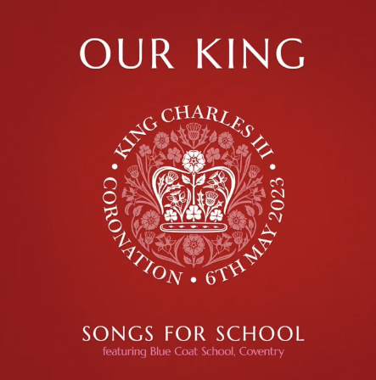
Gather
https://www.youtube.com/watch?v=JcIAZd8p5fQ

Slide 2
3rd May 2023

Slide 3
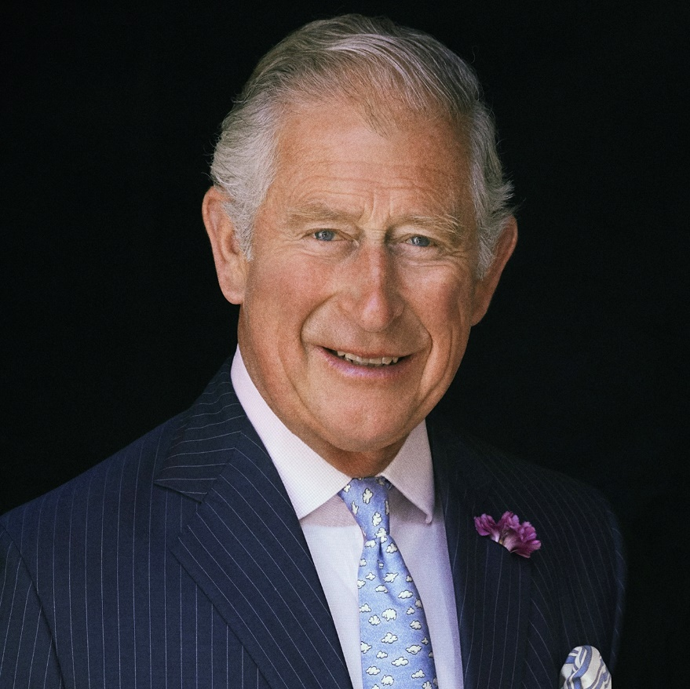
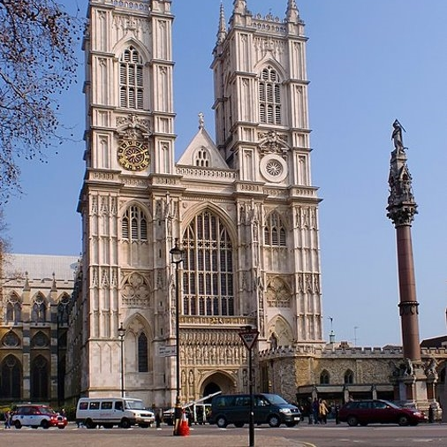
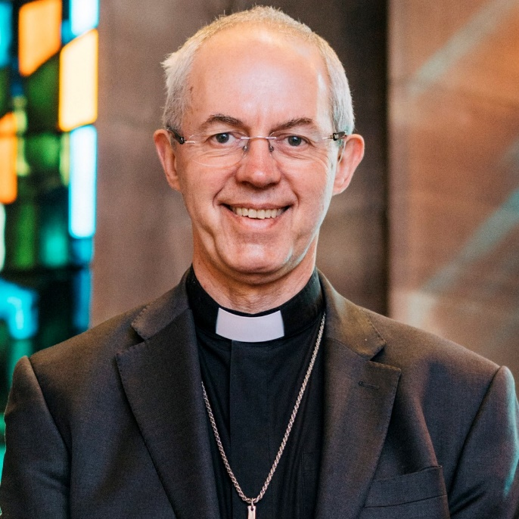
The Coronation of King Charles III
King of the United Kingdom

Slide 4
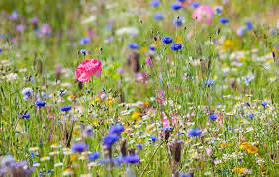
The king has a particular love of nature, the environment and charity works. A pack of wildflower seeds will be sent to all schools to plant in the coming weeks to commemorate the coronation.

Slide 5
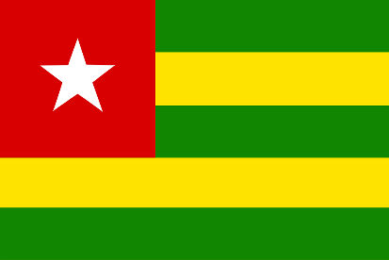
Head of the Commonwealth
As well as King of Great Britain, the King is also the Head of the Commonwealth, a voluntary organisation of 54 independent and equal countries across the world. These countries work together towards common goals and values.

Slide 6
The Coronation Service
The recognition
Right from the start of the service it is recognised that the King is under the authority of God. King Charles will be presented to those gathered in the Abbey by the Archbishop of Canterbury. The congregation will shout ‘God save King Charles!’ and trumpets will sound. Trumpets in the Bible are used at significant festivals, to call people to gather, or to assemble for battle.
The oath
The King will then make a Coronation Oath. The exact words of this promise – to people and to God – has changed over the centuries. Queen Elizabeth II swore to rule with justice and mercy.

Slide 7
The Coronation Service
The anointing
After the oath, the King sits in the Coronation Chair. The Archbishop of Canterbury will anoint the King with holy oil and bless him.
This anointing with oil goes back to the practices described in the Old Testament of setting something apart as special for God’s purposes. A gold cloth has traditionally been held over and around the chair to conceal this sacred event. This is a sacramental act and an important and powerful moment that has similarities with when Christians are baptised, confirmed or ordained.

Slide 8
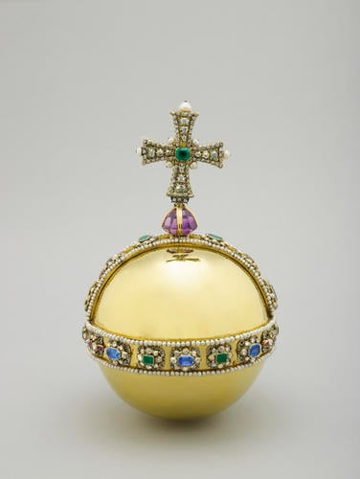
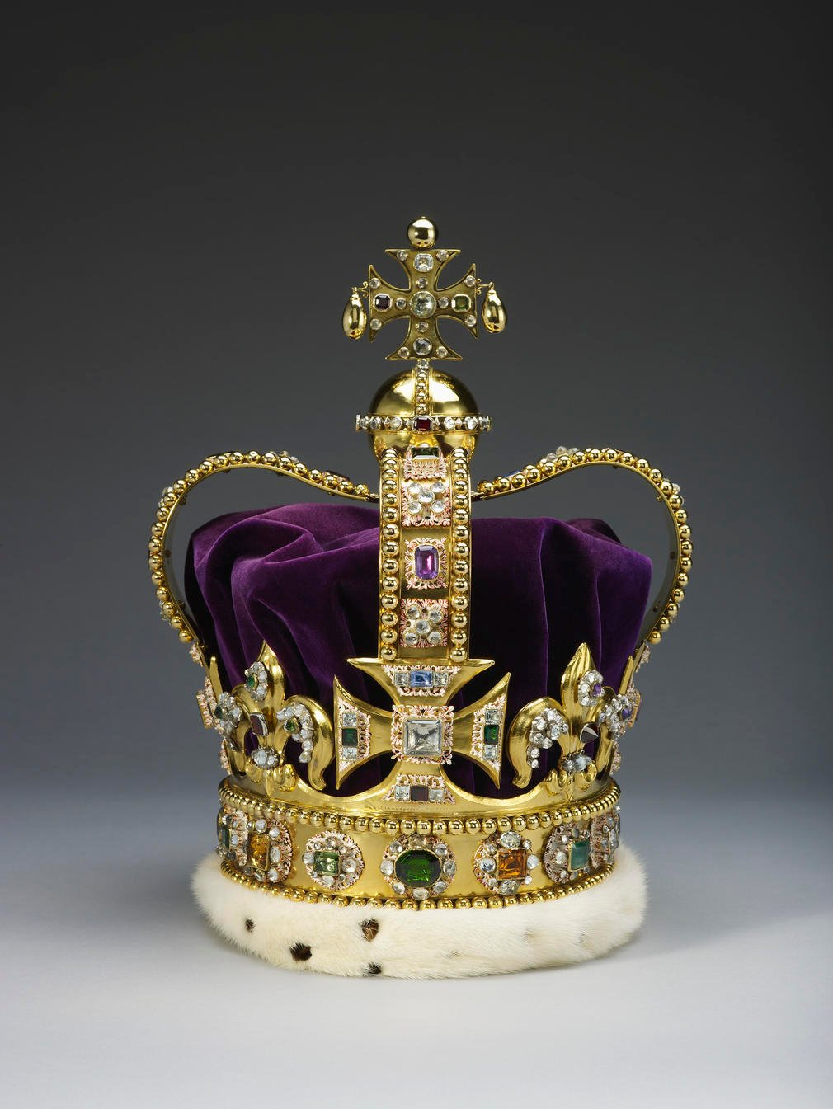
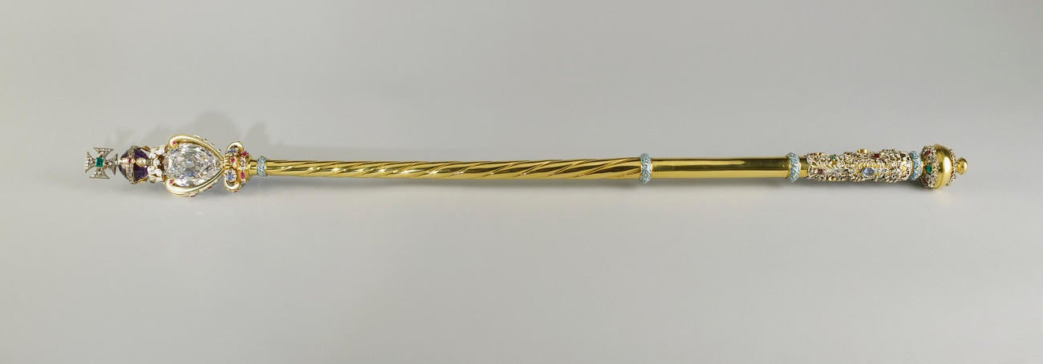
The Coronation Service The Investiture
Notice the symbol of the cross appears on all these. A sign of Christianity. Ultimately the earth is God’s and God will help King Charles in his duties.
The Sovereign’s Orb
St. Edward’s Crown
The Sovereign's Sceptre

Slide 9
The Coronation Service
The enthronement and homage
King Charles III will then move from the Coronation Chair to the throne. Those gathered will kneel before the sovereign to pay respect and special honour to the King. Kneeling is a common act in Christianity and symbolises making ourselves low, so that God can be honoured and metaphorically lifted up.
We can see within the Coronation the ways in which the King will express the ways he wishes to follow Jesus’ teaching and example as given in the Beatitudes: be merciful; be pure in heart; be a peacemaker, and hunger and thirst for righteousness. ​
​
Through the Coronation, the King will express what he wants ‘to do’ and who he wants ‘to be’ as he rules.

Slide 10
Prayerful Reflection
Father God, thank You for King Charles. For his life and service to this day and going forwards from his coronation as King.
Thank You that you know him inside and out. You created him, and us, with a purpose and You are the one who gives us good gifts and talents to be nourished and built up to serve and bless others.
Help him, by your Holy Spirit, to serve wholeheartedly and with joy. Help him to make good decisions and to guide and protect those he serves.
As we have thought about his coronation and all that this signifies, help us to recognise our own gifts, calls upon our lives and our spheres of influence. Might we always be seeking the good of not only ourselves but those around us, and might we have servant hearts, like Jesus, so that we think of the others’ needs, amplify the voices of those weakest in society, and see the Kingdom of God lived out in our every day.
We pray in Jesus’ name, Amen.

